Slide 1
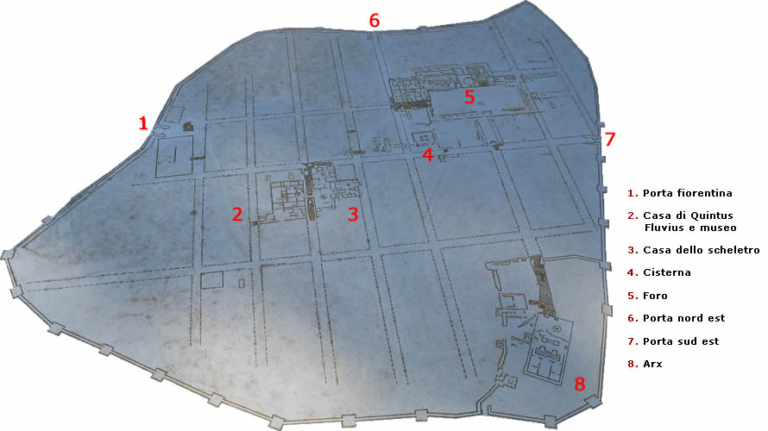
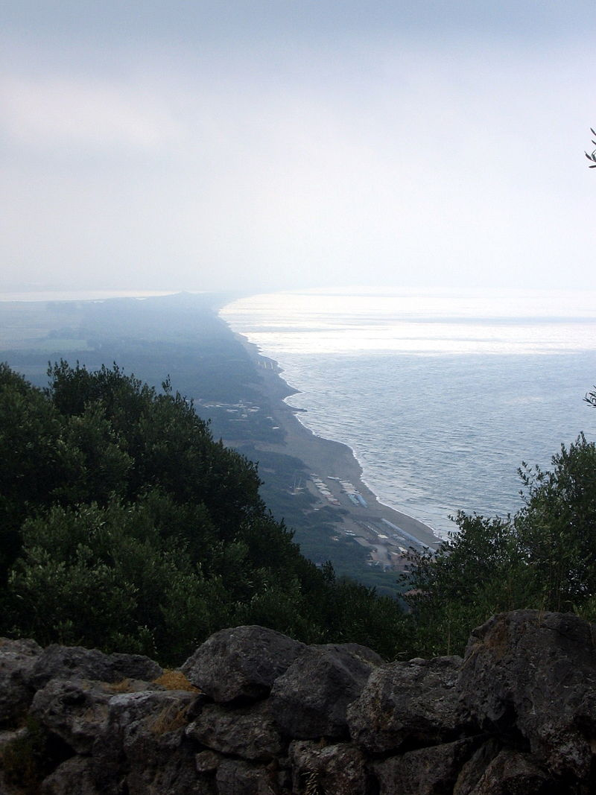

Lets Take a Trip to Cosa
The ancient roman city on top of the hill
Demi-lee Pretorius

Slide 2

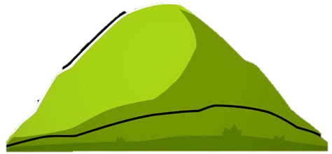

A Brief History of Cosa
Cosa also known as Cusi or Cusia (by the Etruscans)
a village founded by the Romans in 273 BC.
It was founded on land confiscated from the Etruscans.
Protected Port
113 meters above sea level and is 140 km northwest of Rome
People who live here had a hard life
Never became the prosperous village that the Romans thought it would
Cosa

Slide 3
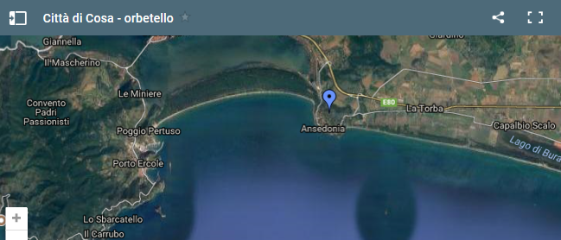
Map of Cosa

Slide 4

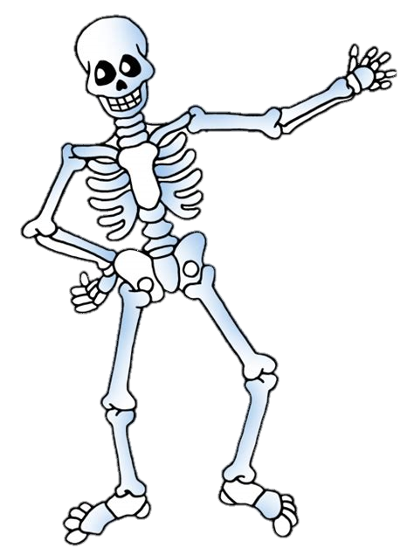
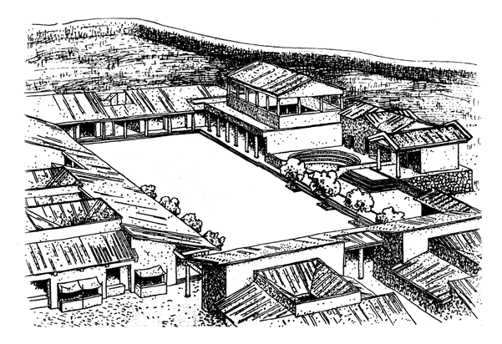
Excavations at Cosa
Excavations at the site of Cosa have gone on under the American Academy in Rome
The port and fishery and the ruins at the top of the hill
Political and religious practices, trade, land use and artisanal activity.
A Pirates life for thee?
Murder on top of the hill

Slide 5
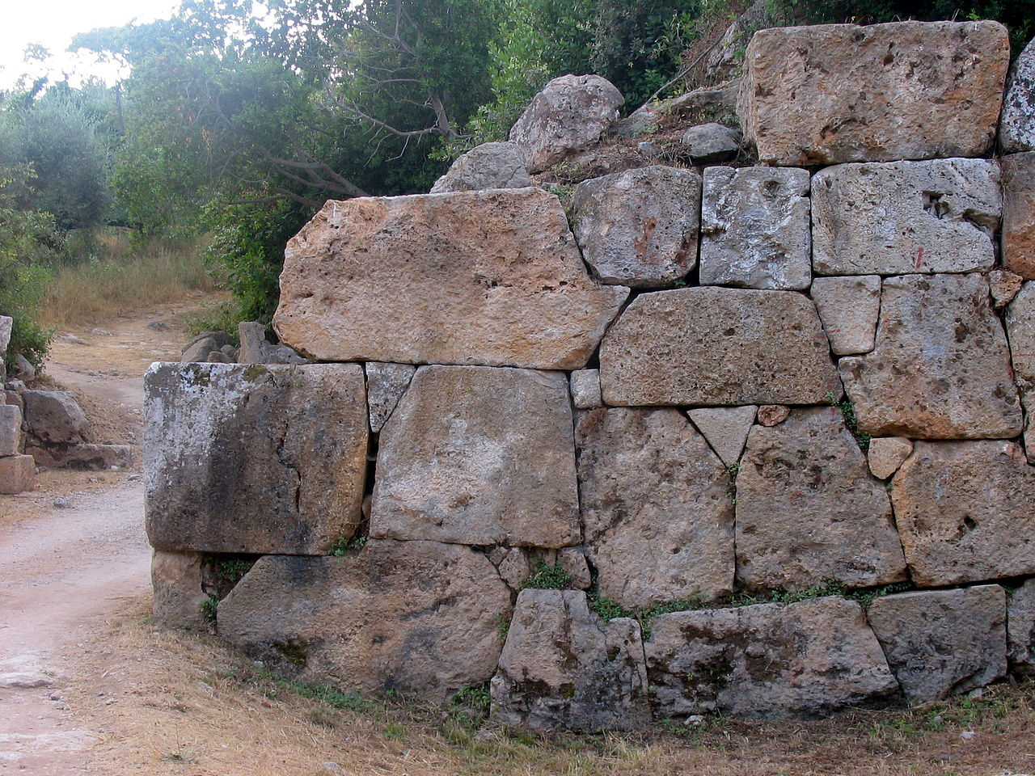
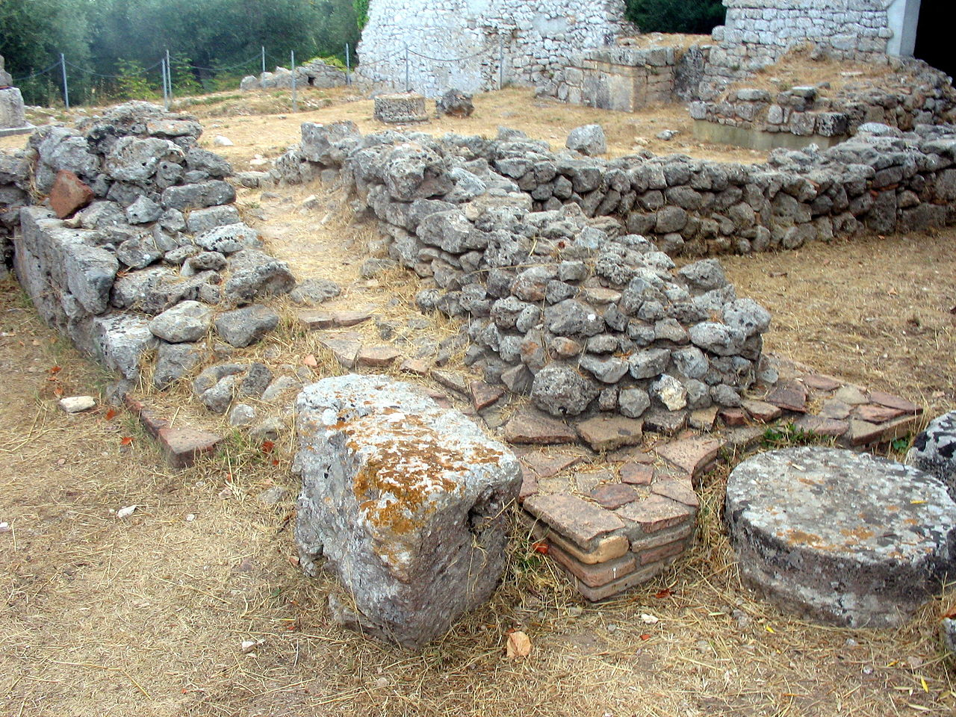
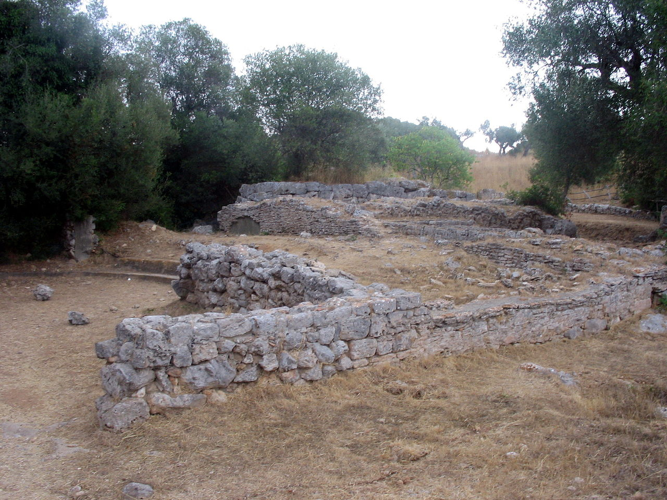
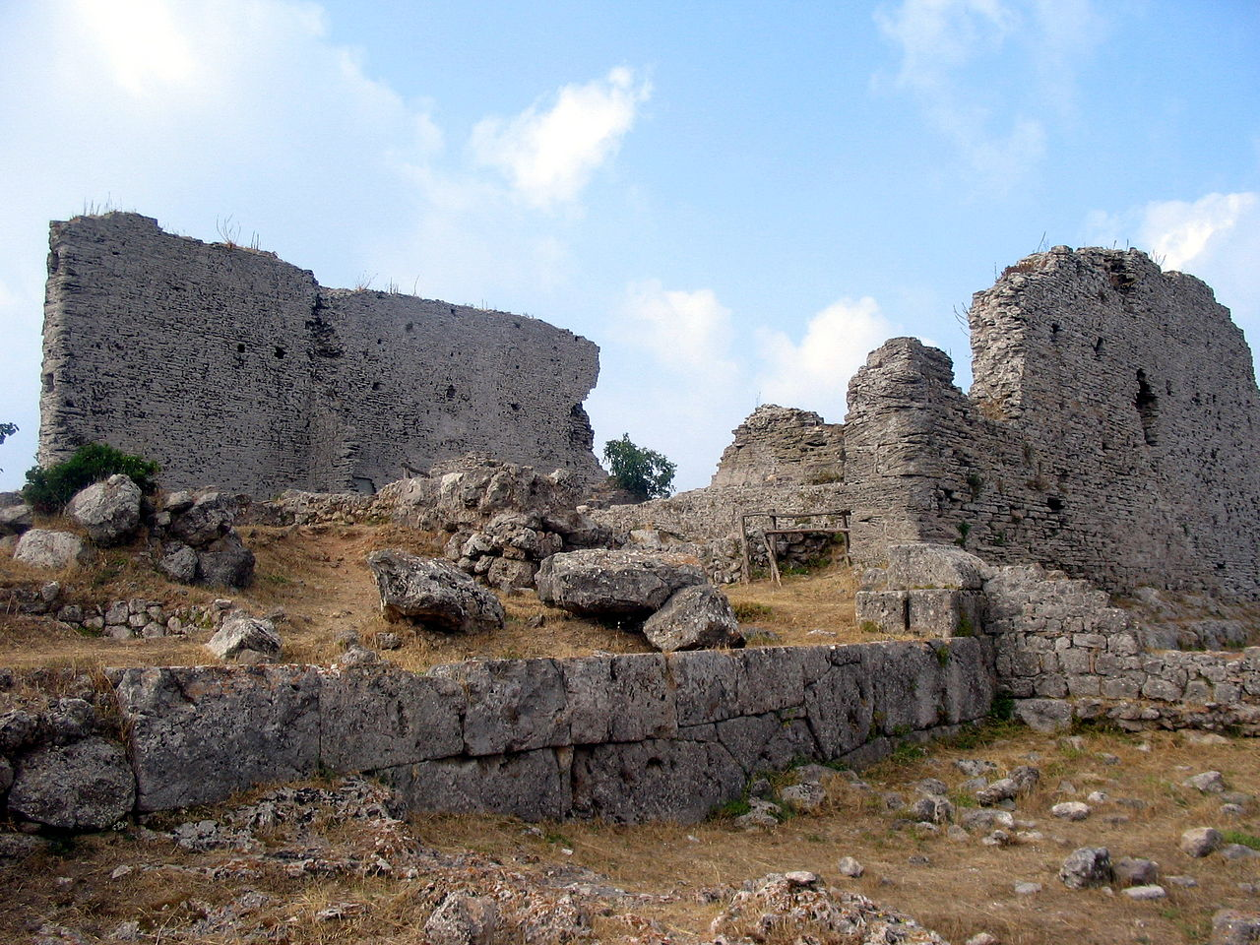
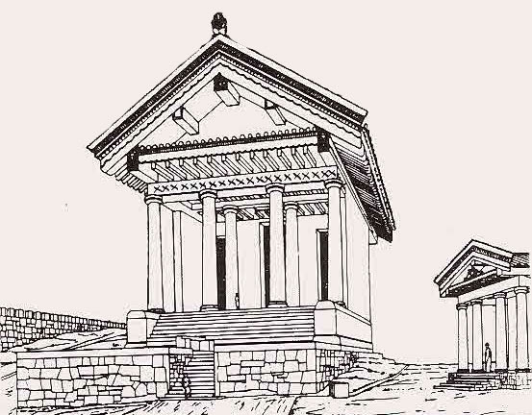
Cosa and its Many Parts
Masornary Circuit Wall
Surrounded Cosa
included a system of interval towers
Basilica in the Forum
Court of law or building for public gatherings
Capitolum
- Temple at the top of the hill
Curia and Comitium
- Hall of records and Meeting

Slide 6
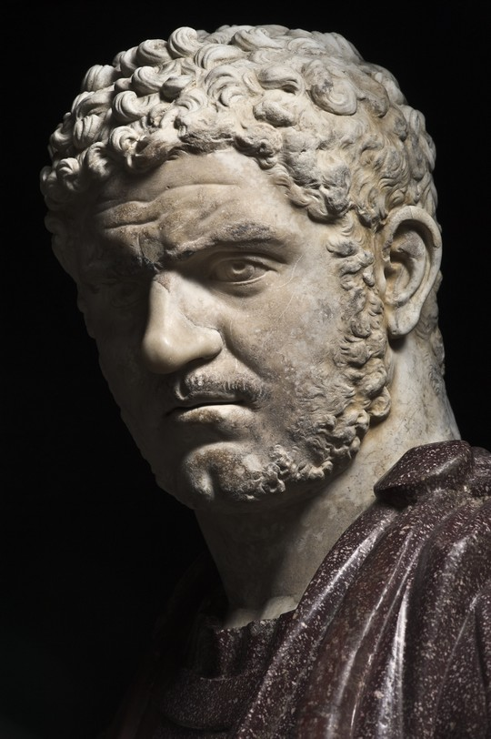
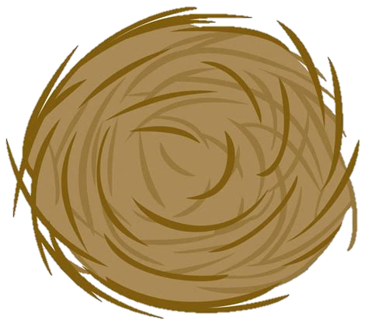
The Destruction and Reconstruction of Cosa
Earthquake
Lucius Titinius Glaucus Lucretianus
After its reconstruction Cosa went through long periods of desertion
Under Emperor Caracalla the port city was revived
The new town did not last long
It was Abandoned again and then used as a small fortified outpost under Byzantine control.
The cause of the seasonal and sometimes deserting of the town has been linked to malaria

Slide 7
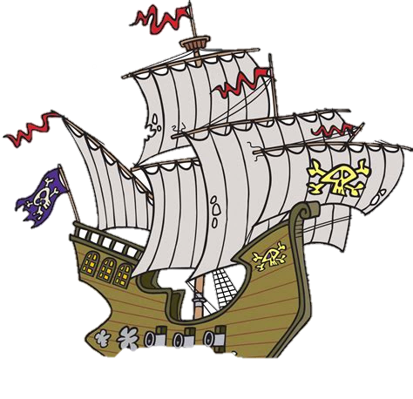

The Importance of Cosa
Roman harbor construction and trade.
Man-made harbors of the Roman Empire
The Port of Cosa provides archaeologists and historians with the earliest Known Roman harbor
The earliest commercial fishery
As well as the earliest use of concrete in water

Slide 8
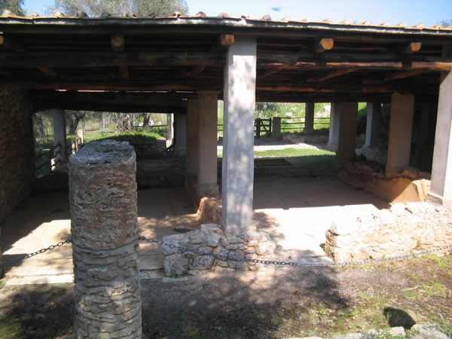
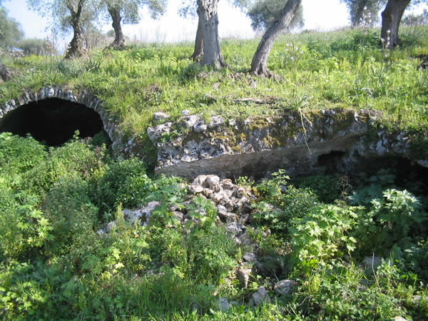
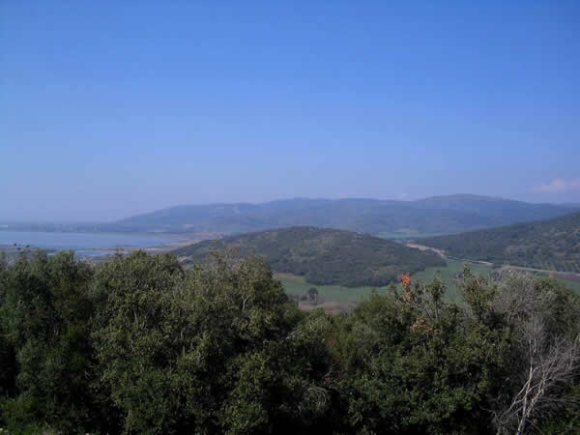
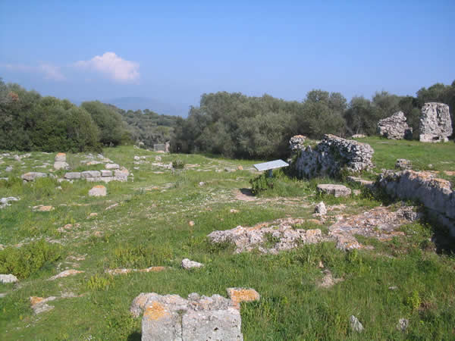
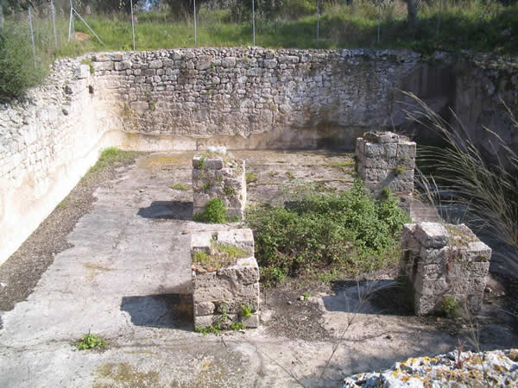
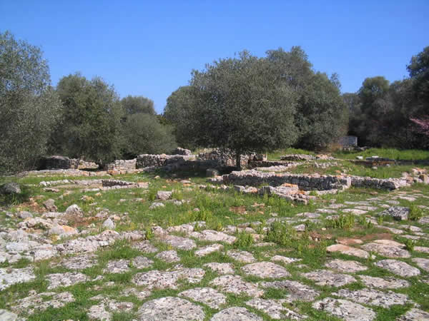
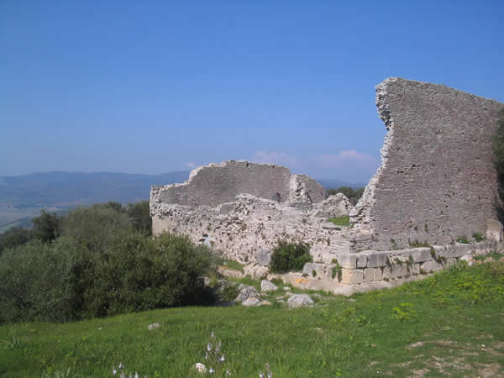
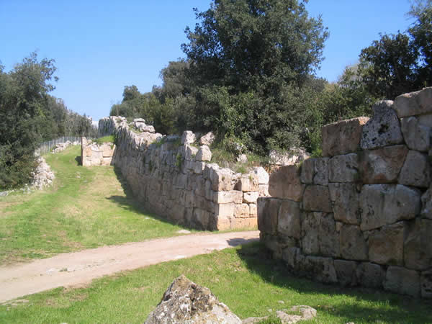
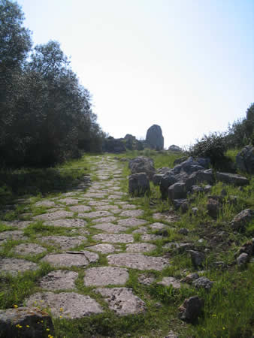
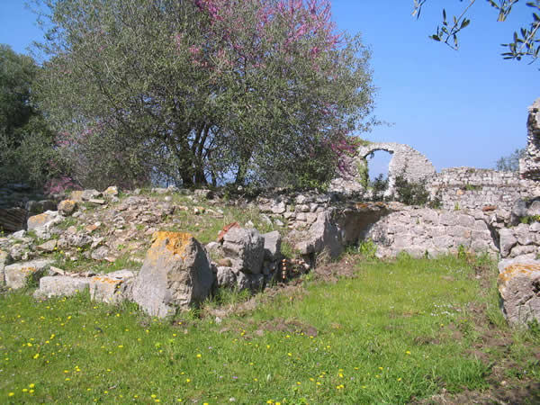
Some Pics from your memorable Trip

Slide 9

Thank You for Visiting

Slide 10
Works Cited
“Ancient Roman Town of Cosa .” Ancient Roman Town of Cosa, TuttoMaremma.com, www.tuttomaremma.com/en/romantownofcosa.htm.
Brennan, Matthew. “Cosa.” Cosaexcavations.org, 2016, www.cosaexcavations.org/history/.
Bing, Microsoft, www.bing.com/Images.
“Students to spend summer re-Creating Ancient Rome’s Cosa in 3-D imagery.” The Daily, Case Western Reserve University, 14 Feb. 2012, thedaily.case.edu/students-to-spend-summer-recreating-ancient-romes-cosa-in-3-d-imagery/.

